Slide 1

Xploit Streaming music app

Slide 2

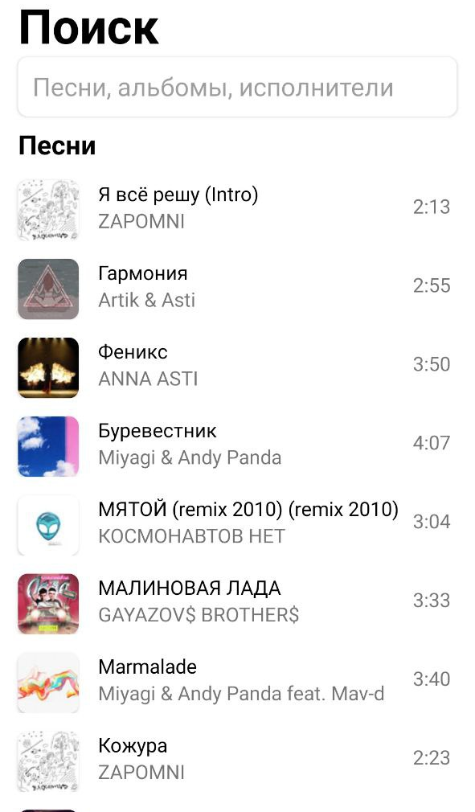
Что такое Xploit?
Xploit — стриминговое приложение, позволяющее прослушивать музыкальные композиции, не скачивая их на устройство.
2

Slide 3
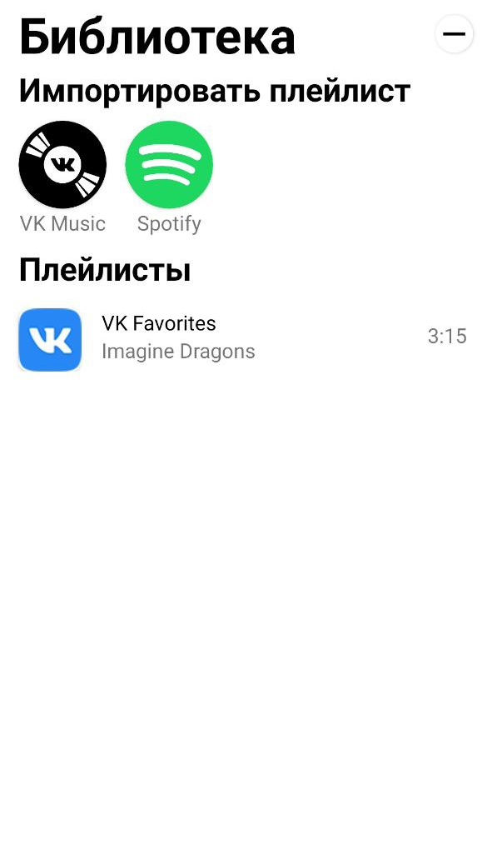
В чём отличие от других сервисов?
Xploit – это первое приложение, позволяющее собрать ваши музыкальные библиотеки из других приложений или сервисов в одном месте.
Для приложения не нужна регистрация. Запустил – и можно пользоваться!
3

Slide 4
Функционал Подборка популярных песен
Первое, что нас встречает на главном экране приложения - подборка популярных (по количеству прослушиваний) песен, а также строка поиска.
4

Slide 5
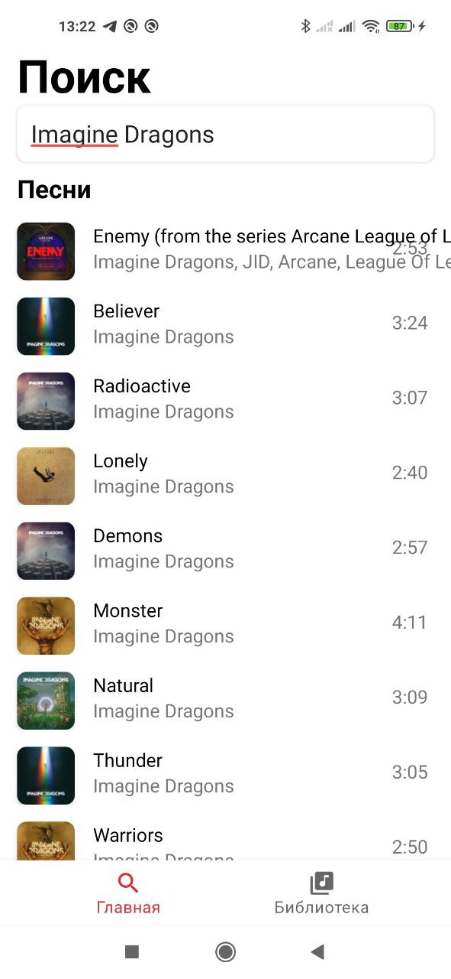
Функционал Поиск
Имеется возможность поиска треков по названию или исполнителю
5

Slide 6
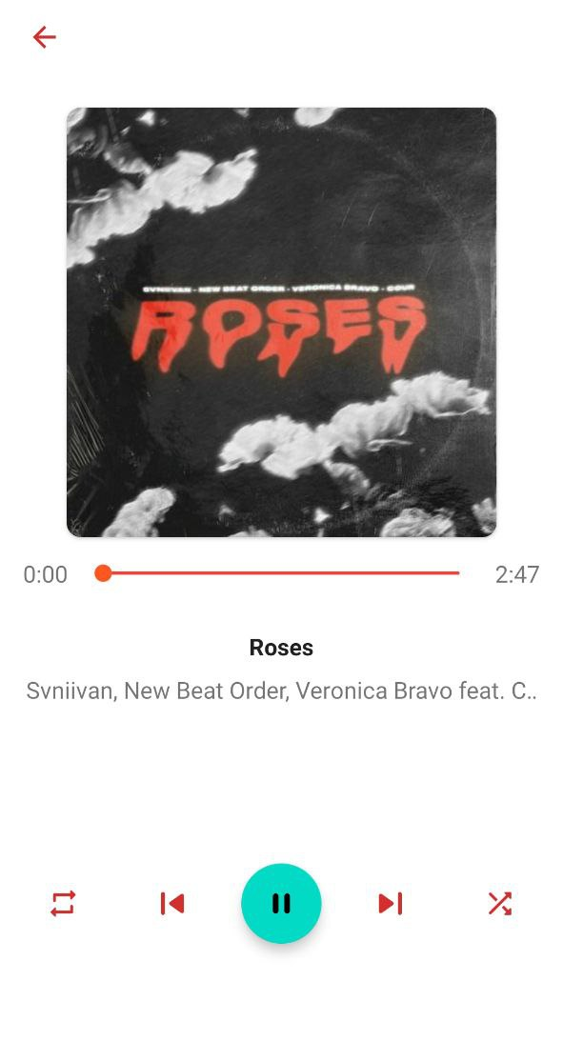
Функционал Плеер
Как и в любом уважающем себя музыкальном сервисе, в Xploit есть плеер с реализованной функциональностью:
Кнопки Play/Pause, перемещение вперёд/назад по прейлисту
Возможности включения повтора
Возможности перемешивания треков в плейлисте
Подгрузки картинки трека
Кэширования треков
6

Slide 7
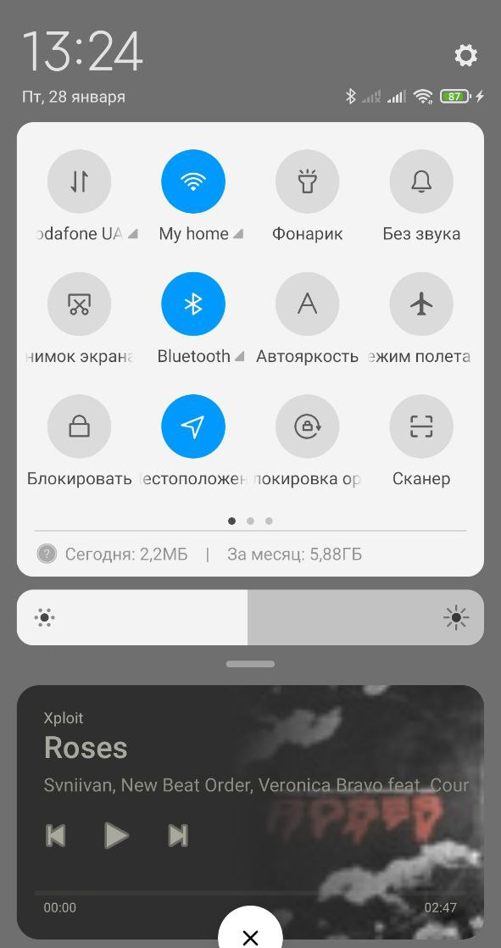
Функционал Плеер
Плеер доступен не только в самом приложении, но и в шторке уведомлений на устройстве, также с возможностью управления воспроиздением.
Фон в мини-плеере выставляется соответственно проигрываемому треку, цвет текста и кнопок автоматически подстраиваются под фон.
7

Slide 8

Функционал Импорт плейлистов из других приложений
На данный момент поддерживается импорт из VK Music. Импорт из Spotify уже в разработке =)
В дальнейшем планы на добавление:
Youtube Music
Soundcloud
Apple Music
8

Slide 9
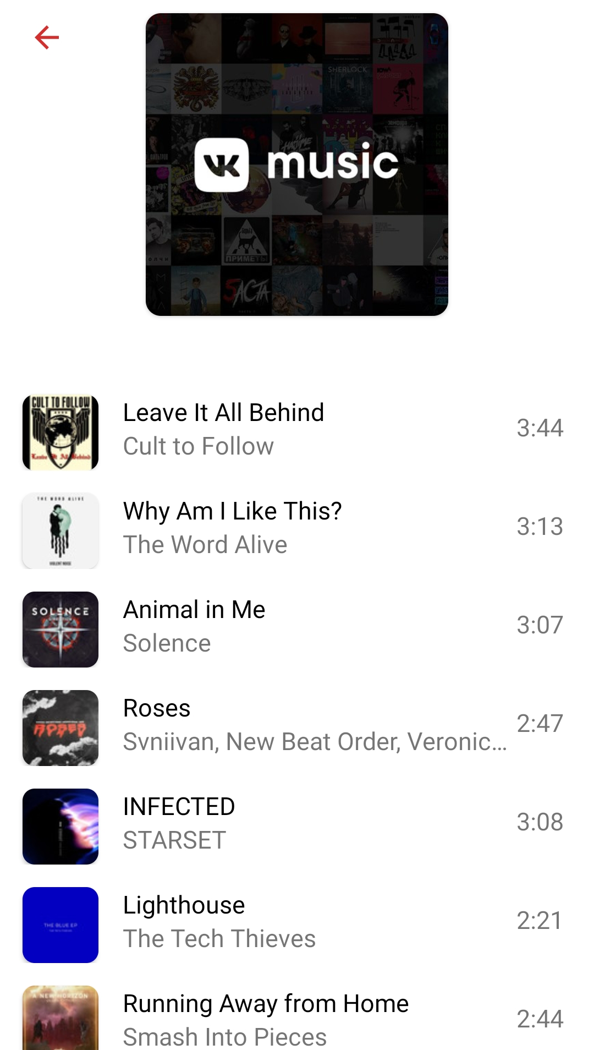
Функционал Импорт плейлистов из других приложений
Пример импортированного плейлиста
9

Slide 10






Сервисы
Как это работает?
Тут хранятся API ключи
Xploit Backend
Библиотека музыки
Xploit App
10

Slide 11
Дальнейшее развитие
Для дальнейшего развития запланировано:
Функция сохранения трека для оффлайн прослушивания
Функция сохранения трека в mp3
Подключение новых сервисов
Переход на систему базы данных для плейлистов
Пофиксить баги синхронизации мини-плеера и UI
Добавить багов, чтобы было, что фиксить
11

Slide 12

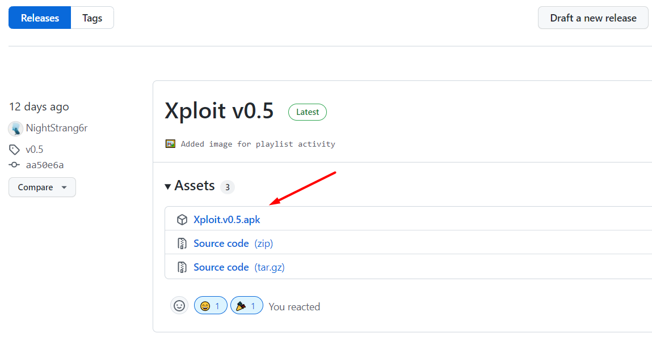
Загрузить Xploit
Загрузить последнюю версию можно с GitHub по ссылке
https://github.com/NightStrang6r/Xploit/releases
12

Slide 13
Thank you
Mail a@leoitdev.ru
Site leoitdev.ru

Slide 14
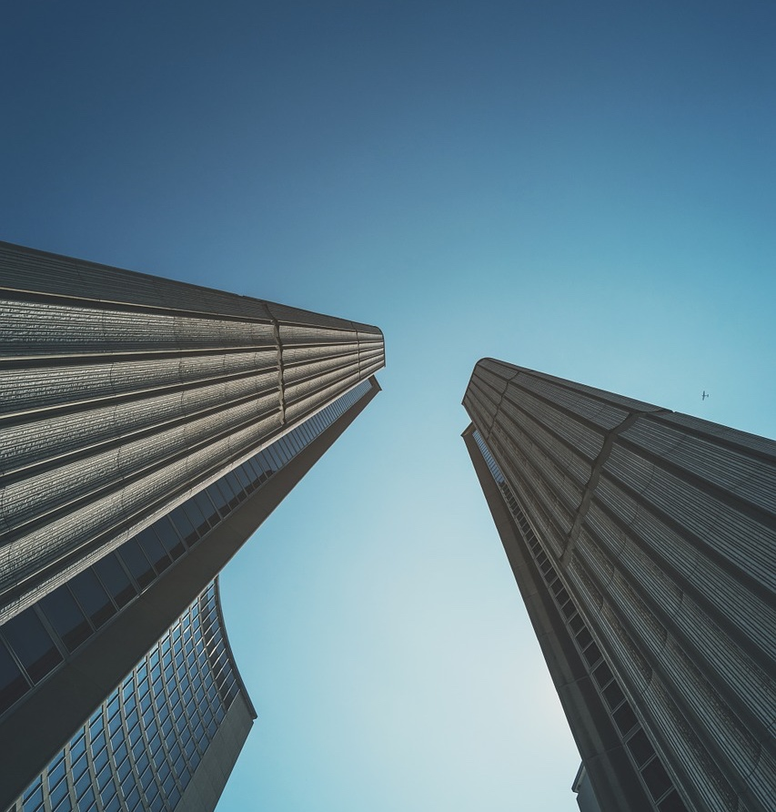
Round design Template
London is the capital of Great Britain, its political, economic and cultural center. It's one of the largest cities in the world. Its population is more than million people.
London is the capital of Great Britain, its political, economic and cultural center. It's one of the largest cities in the world.

Slide 15

London is the capital of Great Britain, its political, economic and cultural center.
London is the capital of Great Britain, its political, economic and cultural center.
London is the capital of Great Britain, its political, economic and cultural center.
London is the capital of Great Britain, its political, economic and cultural center.
London is the capital of Great Britain, its political, economic and cultural center.

Slide 16

Round design Template
London is the capital of Great Britain, its political, economic and cultural center. It's one of the largest cities in the world.
London is the capital of Great Britain, its political, economic and cultural center.
London is the capital of Great Britain, its political, economic and cultural center.
London is the capital of Great Britain, its political, economic and cultural center.
16

Slide 17

Round design Template
TEMPLATE
London is the capital of Great Britain, its political, economic and cultural center. It's one of the largest cities in the world. Its population is more than million people.
London is the capital of Great Britain, its political, economic and cultural center. It's one of the largest cities in the world.

Slide 18




Round design Template
London is the capital of Great Britain, its political, economic and cultural center.
London is the capital of Great Britain, its political, economic and cultural center.

Slide 19

Round design Template
London is the capital of Great Britain, its political, economic and cultural center. It's one of the largest cities in the world. Its population is more than million people.
London is the capital of Great Britain, its political, economic and cultural center. It's one of the largest cities in the world.

Slide 20




Round design Template
London is the capital of Great Britain, its political, economic and cultural center. It's one of the largest cities in the world. Its population is more than million people.

Slide 21

Round design Template
London is the capital of Great Britain, its political, economic and cultural center. It's one of the largest cities in the world. Its population is more than million people.
London is the capital of Great Britain, its political, economic and cultural center. It's one of the largest cities in the world.

Slide 22
London is the capital of Great Britain, its political, economic and cultural center.
London is the capital of Great Britain, its political, economic and cultural center.
Round design Template
London is the capital of Great Britain, its political, economic and cultural center.
London is the capital of Great Britain, its political, economic and cultural center.
22

Slide 23


HEADLINE 01
London is the capital of Great Britain, its political, economic and cultural center.
HEADLINE 02
London is the capital of Great Britain, its political, economic and cultural center.
London is the capital of Great Britain, its political, economic and cultural center.
HEADLINE 03
London is the capital of Great Britain, its political, economic and cultural center.
23

Slide 24



01
HEADLINE
London is the capital of Great Britain, its political, economic.
02
HEADLINE
London is the capital of Great Britain, its political, economic.
03
HEADLINE
London is the capital of Great Britain, its political, economic.
24

Slide 25

TEMPLATE
Round design Template
London is the capital of Great Britain, its political, economic and cultural center. It's one of the largest cities in the world. Its population is more than million people.
BUTTON
25

Slide 26



Round design Template
London is the capital of Great Britain, its political, economic and cultural center. It's one of the largest cities in the world.
London is the capital of Great Britain, its political, economic and cultural center.
London is the capital of Great Britain, its political, economic and cultural center.
26

Slide 27

Round design Template
London is the capital of Great Britain.
London is the capital of Great Britain, its political, economic and cultural center.

Slide 28

Round design Template
FIRST THESIS
London is the capital of Great Britain, its political, economic and cultural center.
SECOND THESIS
London is the capital of Great Britain, its political, economic and cultural center.
THIRD THESIS
London is the capital of Great Britain, its political, economic and cultural center.
FOURTH THESIS
London is the capital of Great Britain, its political, economic and cultural center.
28

Slide 29

Round design Template
London is the capital of Great Britain, its political, economic and cultural center.
London is the capital of Great
Britain, its political, economic and
cultural center. It's one of the largest
cities in the world. London is the capital of Great Britain, its political, economic and cultural center. It's one of the largest cities in the world.
London is the capital of Great Britain, its political, economic and cultural center.
London is the capital of Great Britain, its political, economic and cultural center.
29

Slide 30



Round design Template
London is the capital of Great Britain, its political, economic and cultural center. It's one of the largest cities in the world. London is the capital of Great Britain, its political, economic and cultural center. It's one of the largest cities in the world.
London is the capital of Great Britain.
London is the capital of Great Britain.
London is the capital of Great Britain.
30

Slide 31




EMILY
GILBERT
PR manager
HARRY
WILSON
Supervisor
OSCAR
PARSON
Business analyst
MIA
DAVIES
Marketer
31

Slide 32
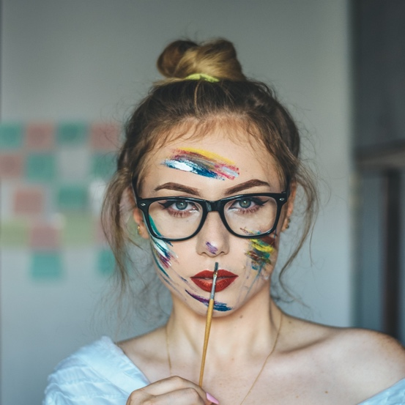
Round design Template
London is the capital of Great Britain, its political, economic and cultural center. It's one of the largest cities in the world. London is the capital of Great Britain, its political, economic and cultural center.
32

Slide 33



Round design Template
London is the capital of Great Britain, its political, economic and cultural center. It's one of the largest cities in the world. London is the capital of Great Britain, its political, economic and cultural center.
London is the capital of Great Britain, its political, economic and cultural center.
London is the capital of Great Britain, its political, economic and cultural center.
33

Slide 34



Round design Template
63%
London is the capital of Great
Britain, its political, economic and cultural center. It's one of the largest cities in the world. London is the capital of Great Britain, its political, economic and cultural center. It's one of the largest cities in the world.
London is the capital of Great Britain, its political, economic and cultural center.
London is the capital of Great Britain, its political.
34

Slide 35
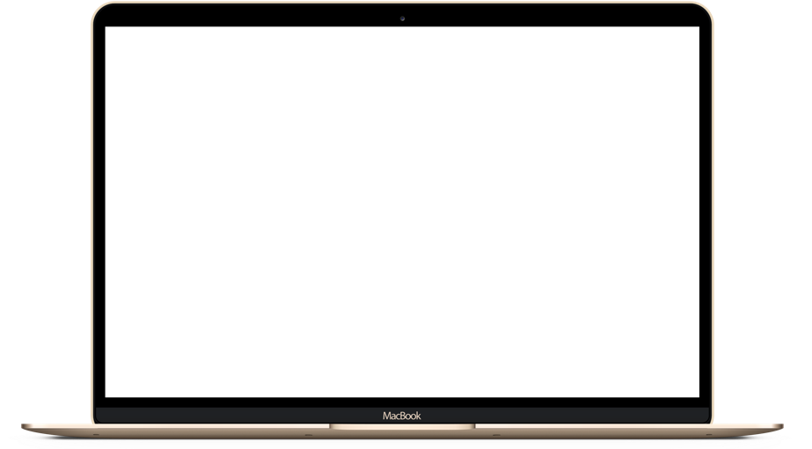

Round design Template
London is the capital of Great Britain, its political, economic and cultural center. It's one of the largest cities in the world.
London is the capital of Great Britain.
London is the capital of Great Britain.

Slide 36

Round design Template
33%
London is the capital of Great Britain, its political, economic and cultural center.
London is the capital of Great Britain, its political, economic and cultural center. It's one of the largest cities in the world.
56%
London is the capital of Great Britain, its political, economic and cultural center.
London is the capital of Great Britain, its political, economic and cultural center.
74%
London is the capital of Great Britain, its political, economic and cultural center.
London is the capital of Great Britain, its political, economic and cultural center. It's one of the largest cities in the world.
36

Slide 37





Round design Template
HEADLINE
London is the capital of Great Britain, its political, economic and cultural center.
HEADLINE
London is the capital of Great Britain, its political, economic and cultural center.
HEADLINE
London is the capital of Great Britain, its political, economic and cultural center.
HEADLINE
London is the capital of Great Britain, its political, economic and cultural center.
37

Slide 38
London is the capital of Great Britain, its political, economic and cultural center. It's one of the largest cities in the world.
London is the capital of Great Britain, its political, economic and cultural center. It's one of the largest cities in the world.
London is the capital of Great Britain, its political, economic and cultural center. It's one of the largest cities in the world.
London is the capital of Great Britain, its political, economic and cultural center. It's one of the largest cities in the world.
London is the capital of Great Britain, its political, economic and cultural center. It's one of the largest cities in the world.
London is the capital of Great Britain, its political, economic and cultural center. It's one of the largest cities in the world.
38

Slide 39

S
Strengths
London is the capital of Great Britain, its political, economic and cultural center.
Round design Template
W
Weaknesses
London is the capital of Great Britain, its political, economic and cultural center.
O
Opportunities
London is the capital of Great Britain, its political, economic and cultural center.
T
Threats
London is the capital of Great Britain, its political, economic and cultural center.
39

Slide 40


Round design Template
London is the capital of Great Britain, its political, economic and cultural center. It's one of the largest cities in the world.
London is the capital of Great Britain
London is the capital of Great Britain
40

Slide 41

46%
89%
82%
52%
46%
Round design Template
London is the capital of Great Britain, its political, economic and cultural center. It's one of the largest cities in the world. London is the capital of Great Britain, its political, economic and cultural center. It's one of the largest cities in the world.
JAN
FEB
MAR
APR
MAY
41

Slide 42
HEADLINE
London is the capital of Great Britain, its political, economic and cultural center.
HEADLINE
London is the capital of Great Britain, its political, economic and cultural center.
Round design Template
HEADLINE
London is the capital of Great Britain, its political, economic and cultural center.
HEADLINE
London is the capital of Great Britain, its political, economic and cultural center.
42

Slide 43
Thanks you
Mail template@template.com
Phone +7 922 99 99 999
Inst @template

